Slide 2
Lesson 1

Slide 3
Lesson 1

Slide 4
Lesson 1

Slide 6
Lesson 2

Slide 8
Lesson 2

Slide 9
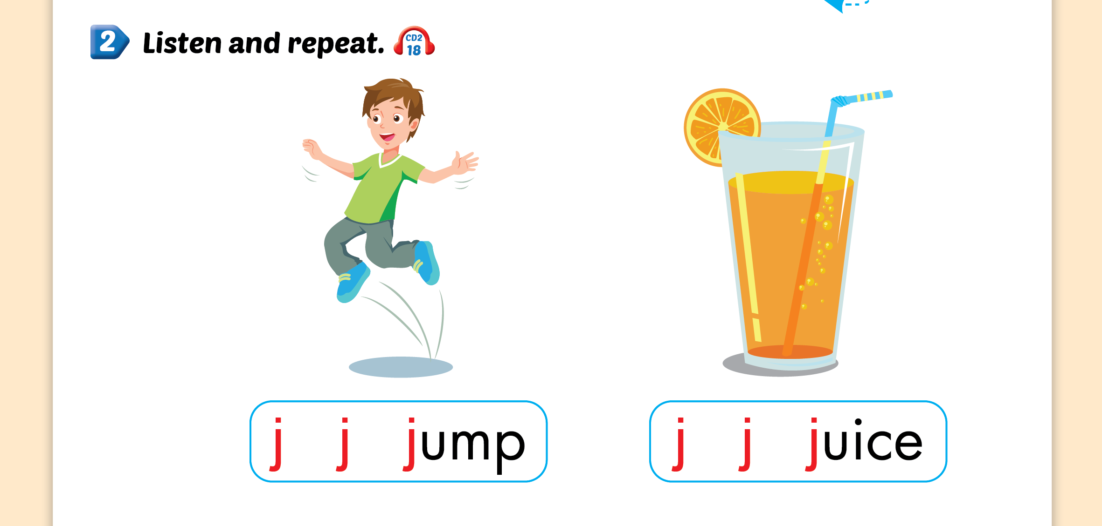
Lesson 2

Slide 12
Lesson 3

Slide 13
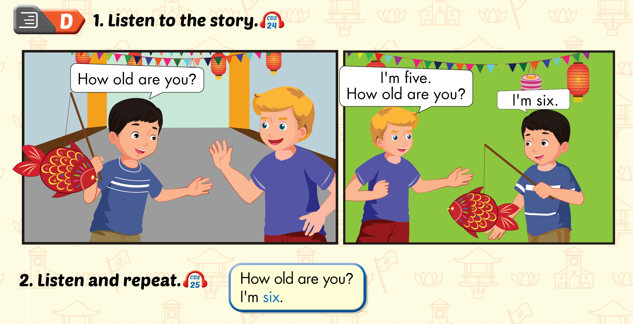
Lesson 3

Slide 14
Lesson 3

